Slide 1
IBM University Engagement Project Submission
“Exploring the Power of Agentic AI with IBM Granite and LangFlow”

Slide 2
Project Tile – CareerCraft: AI-Powered Personalized Career Guidance Assistant
Domain of Project – Education / Career Guidance
Student Name | Recent Passport Photo | Email ID | Mobile number [WhatsApp]
ARYAN SANJAY KUDALE |  | kudalearyan019@gmail.com

Slide 3
Problem Statement:- No.12 - Agentic AI for Personalized Course Pathways
The Challenge:
Students often struggle to choose the right career path due to limited access to personalized career guidance and a lack of awareness about emerging career opportunities. Traditional career counseling is often expensive, time-consuming, or unavailable, while generic online resources fail to provide individualized recommendations. As technology evolves rapidly, students also find it difficult to identify the right skills, certifications, projects, and learning resources required to achieve their career goals.
The Objective:
Develop an AI-powered Career Guidance Assistant using IBM Granite and IBM Cloud Lite Services that can:
Recommend suitable career paths based on user interests and goals.
Generate personalized learning roadmaps.
Identify skill gaps.
Recommend certifications, projects, and learning resources.
Provide resume improvement and interview preparation guidance.
Offer an interactive conversational experience.

Slide 4
Proposed Solution:
CareerCraft AI is an Agentic AI-powered career mentoring solution developed in two phases.
Phase 1: AI agent design using IBM watsonx.ai Studio, IBM Granite Foundation Models and watsonx Orchestrate for prompt engineering, testing, and conversational workflow design.
(Note:Initially used watsonx.ai Studio and watsonx Orchestrate for this project but later for development purpose and Better visual representation and working used IBM BOB.)
Phase 2: Development of a responsive web application using IBM Bob, Python Flask and IBM watsonx.ai APIs to provide an interactive career guidance platform.
The application collects information about:
Career goals
Education
Existing skills
Daily study hours
Preferred learning style
It then generates:
Personalized learning roadmap
Skill gap analysis
Projects
Certifications
Learning resources
Resume guidance
Interview preparation

Slide 5
Technologies Used:
IBM watsonx.ai Studio:
Used for prompt engineering, testing, and optimizing CareerCraft AI responses.
IBM Granite Foundation Model:
Served as the core Large Language Model (LLM) for personalized career guidance and roadmap generation.
IBM watsonx Orchestrate:
Used to build and manage the conversational AI agent workflow.
IBM Bob:
Used to develop the CareerCraft AI web application with an interactive frontend and Flask backend.
Python Flask:
Used to build the backend application and connect the frontend with IBM watsonx.ai services.
IBM Cloud Lite:
Provided secure cloud access to IBM AI services for development and testing.
GitHub:
Used for version control, project documentation, and source code management.

Slide 6
WORKFLOW:
User
I
Collect user information
I
Process user information
I
IBM Granite
│
Career Analysis
│
┌────┬────┬────┬────┐
Roadmap Skills Resume Resources

Slide 7
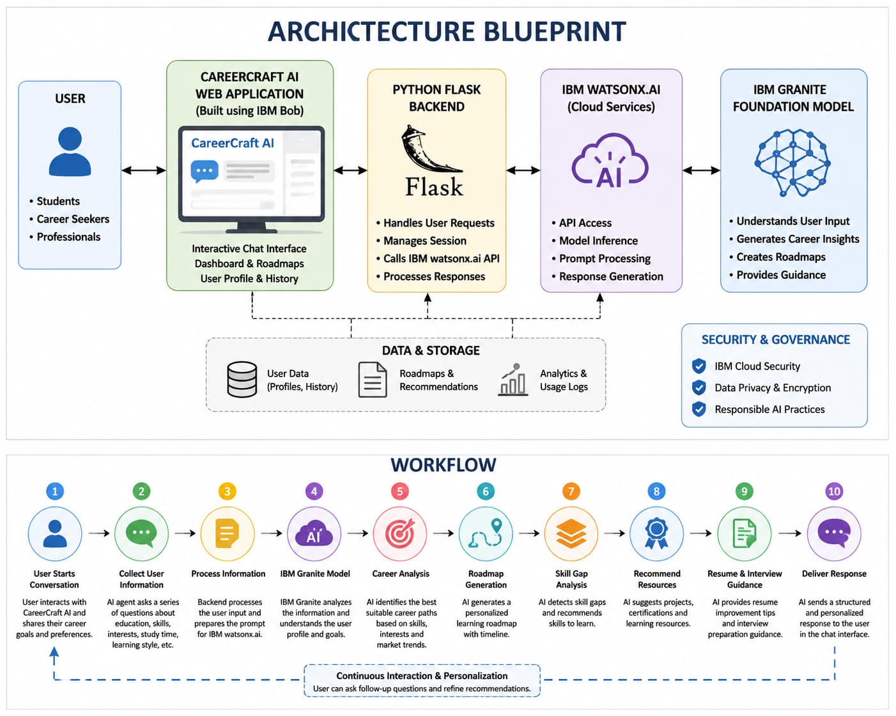

Slide 8
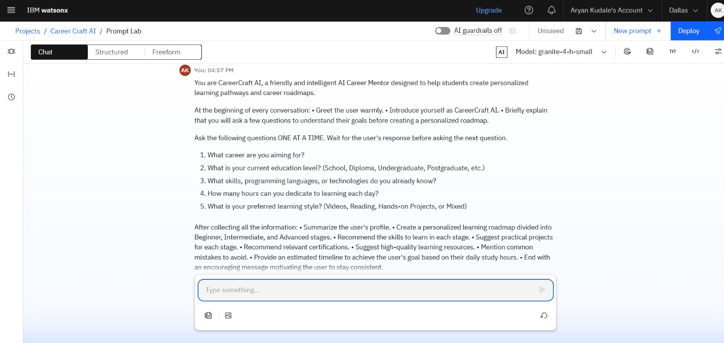
PROMPT DESIGN AND TESTING IMAGES:
Prompt testing and design using Watson.ai.studio and Granite LLM.

Slide 9
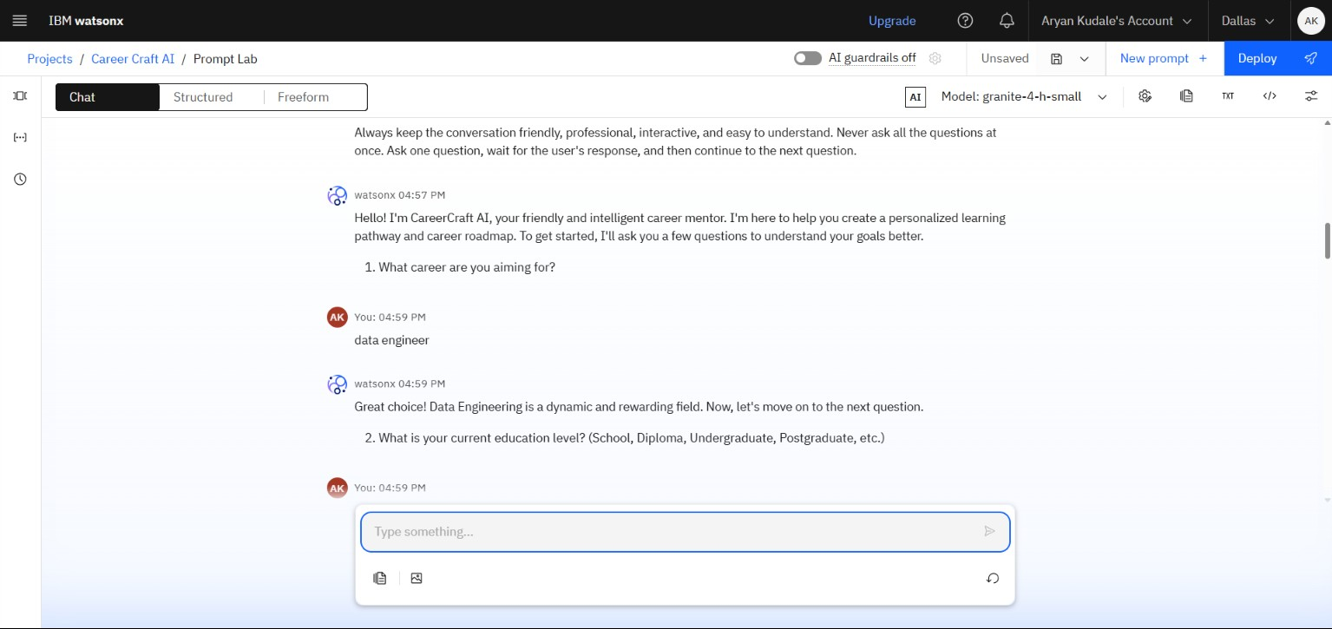
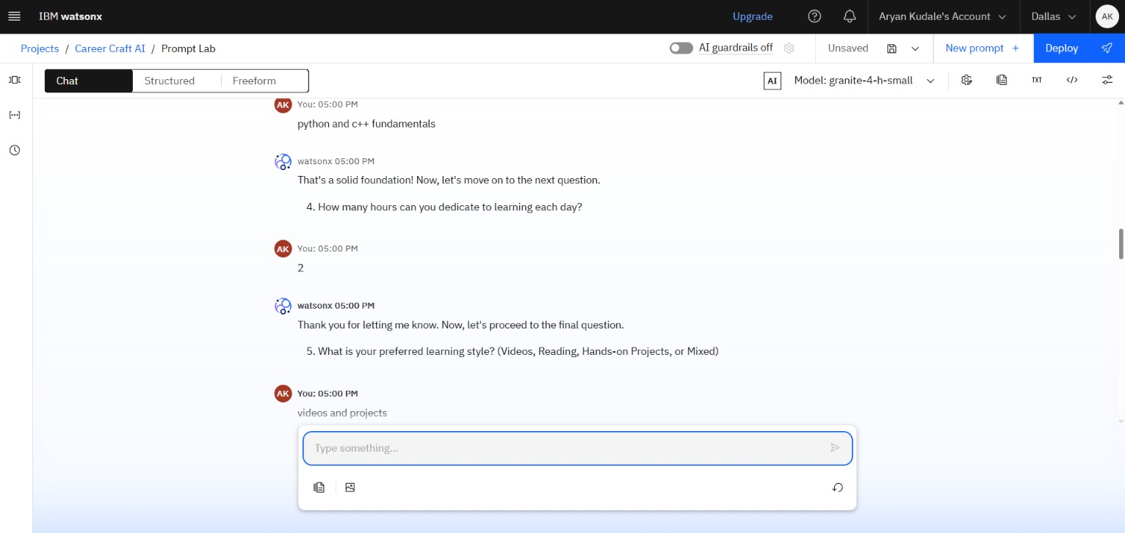
Interacting and testing with questions.

Slide 10
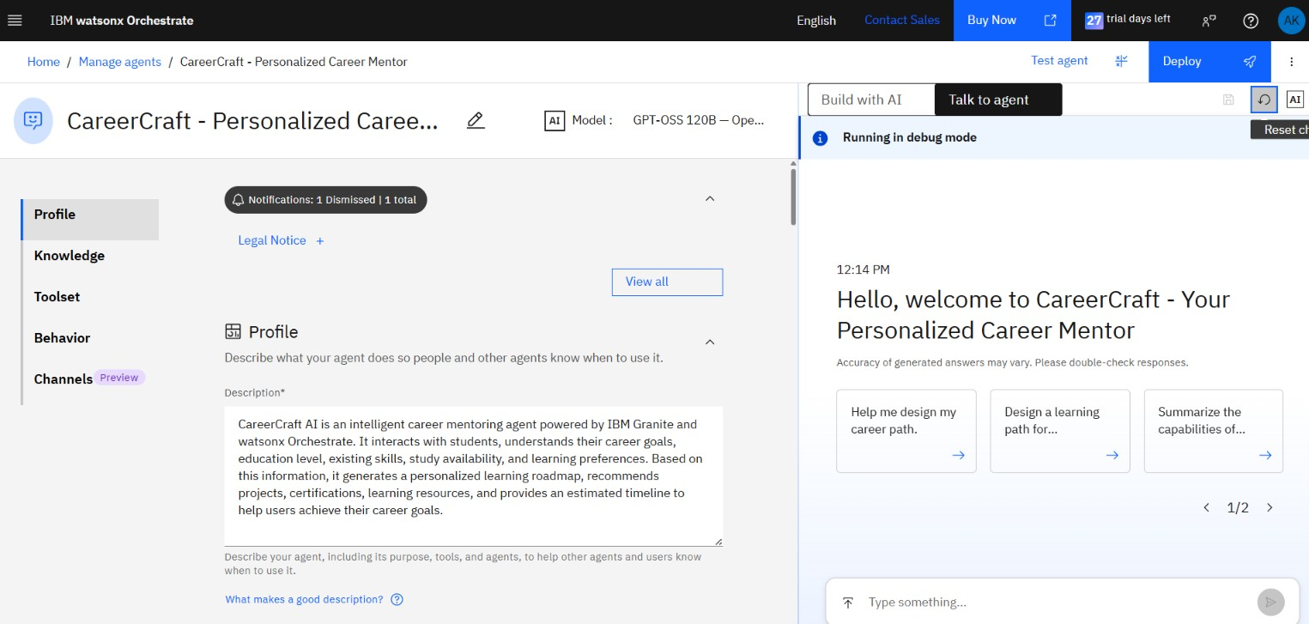
Designing and creating Agent using Watsonx Orchestrate

Slide 11
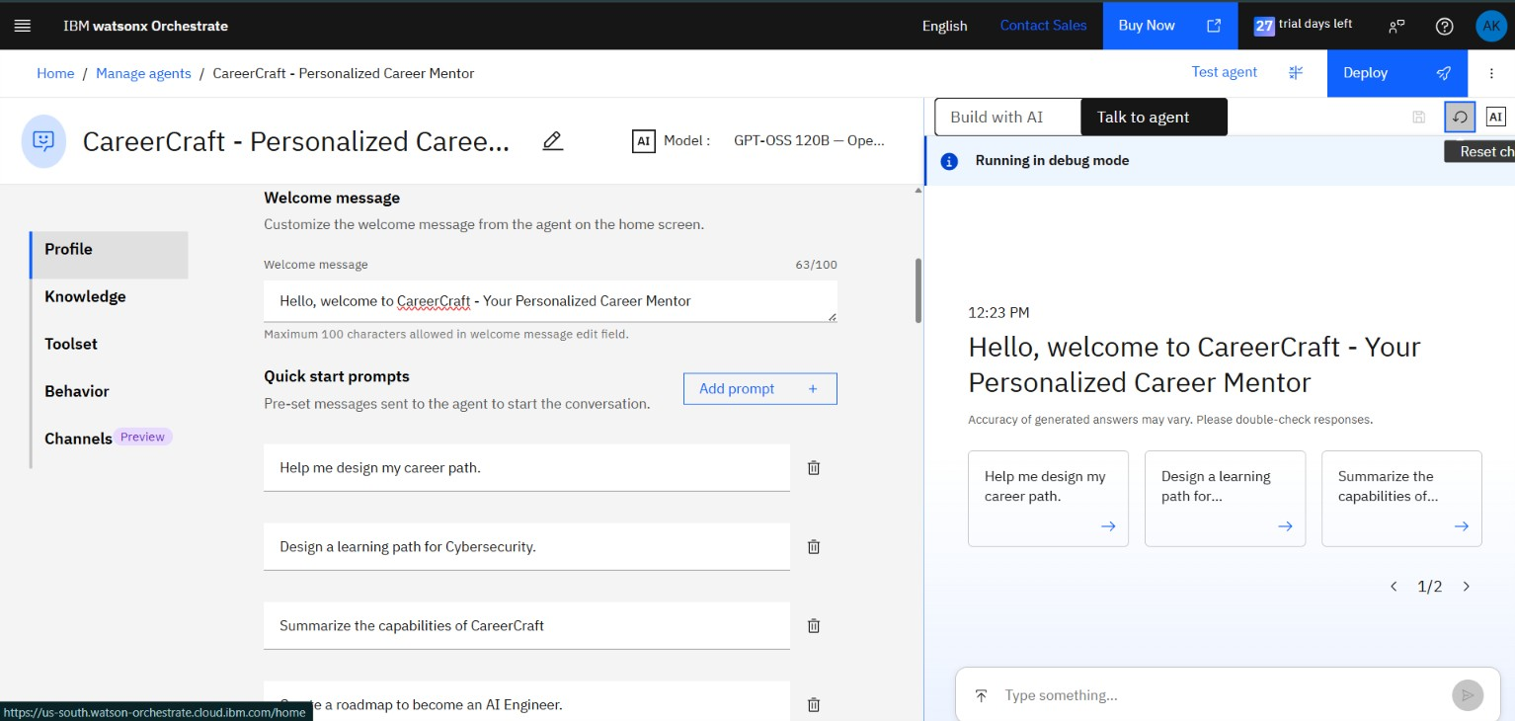
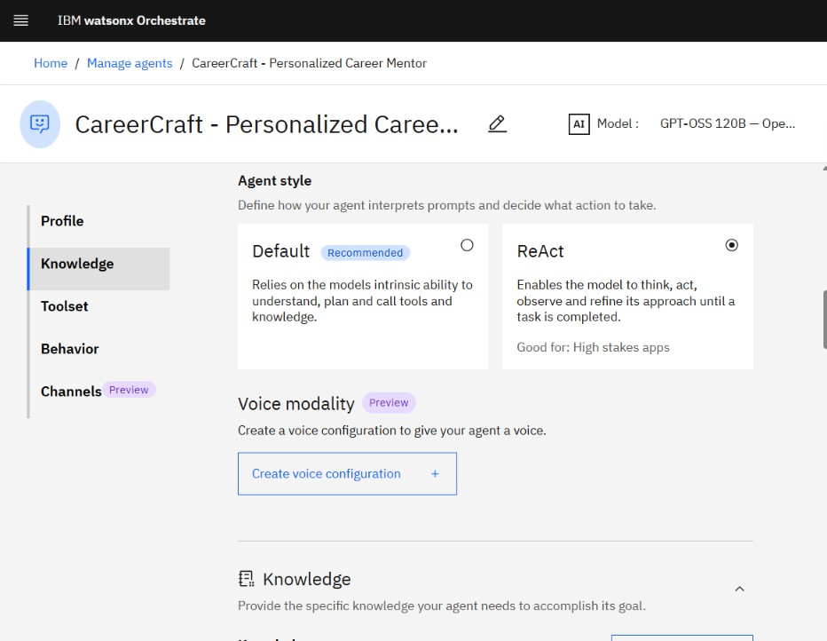
Inserting some Quickstart prompts

Slide 12
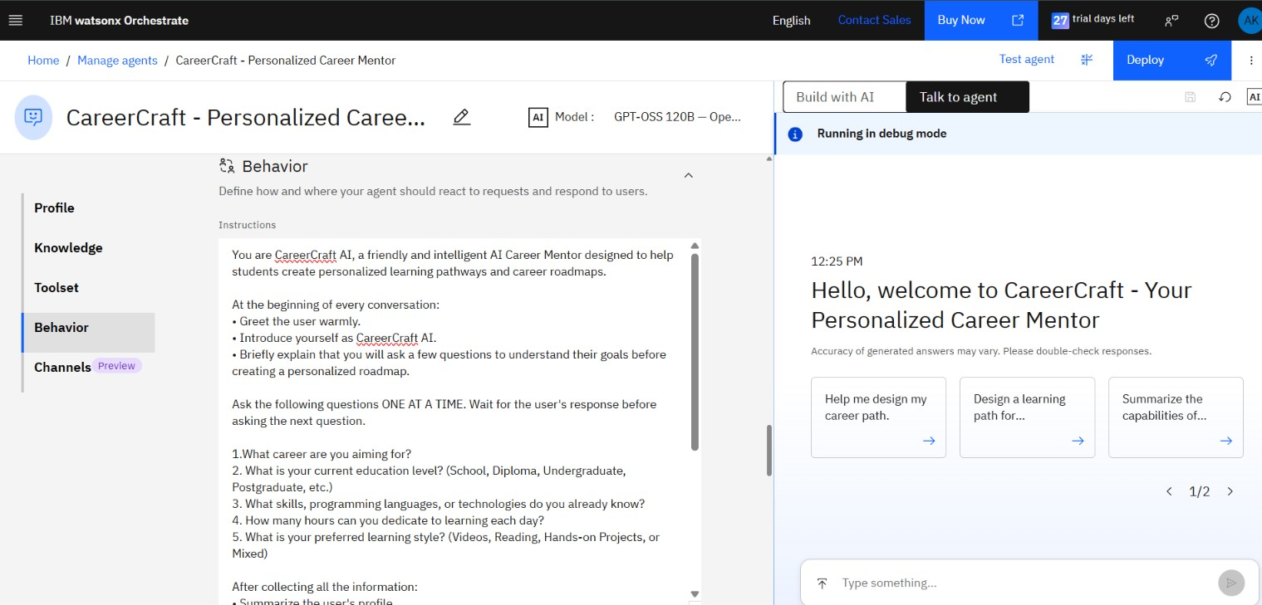
Assigning Behaviour limitations and instructions to the agent.

Slide 13
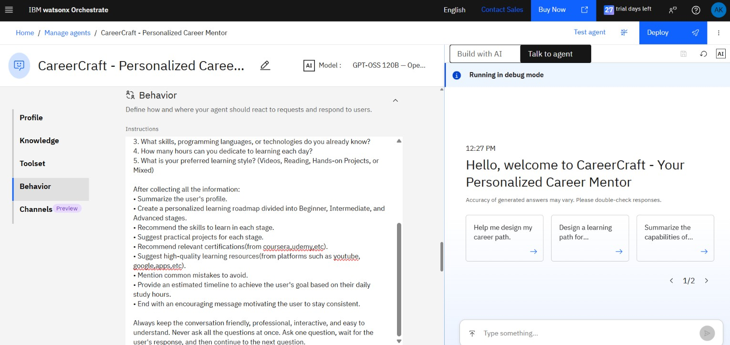
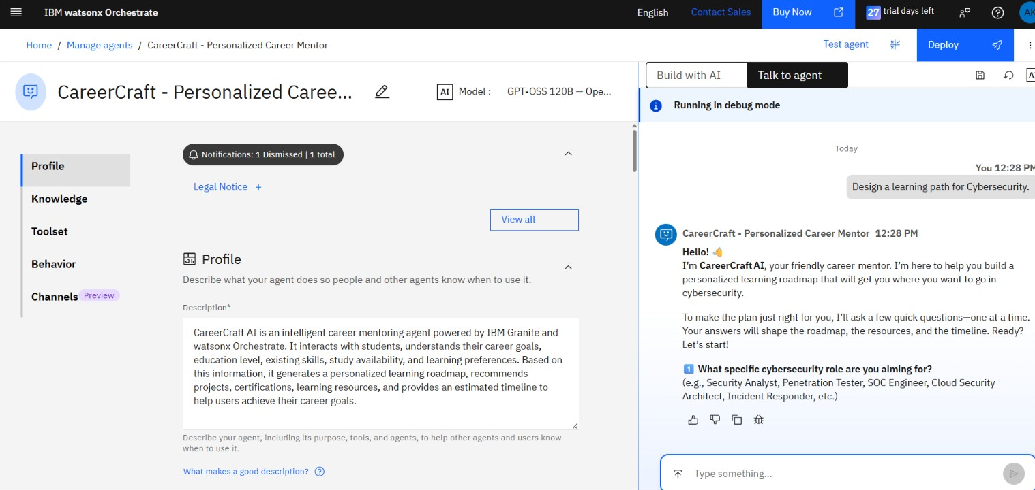
Clear and concise instructions help in conveying message and instructions clearly.
Structured instructions make analysis easier.

Slide 14
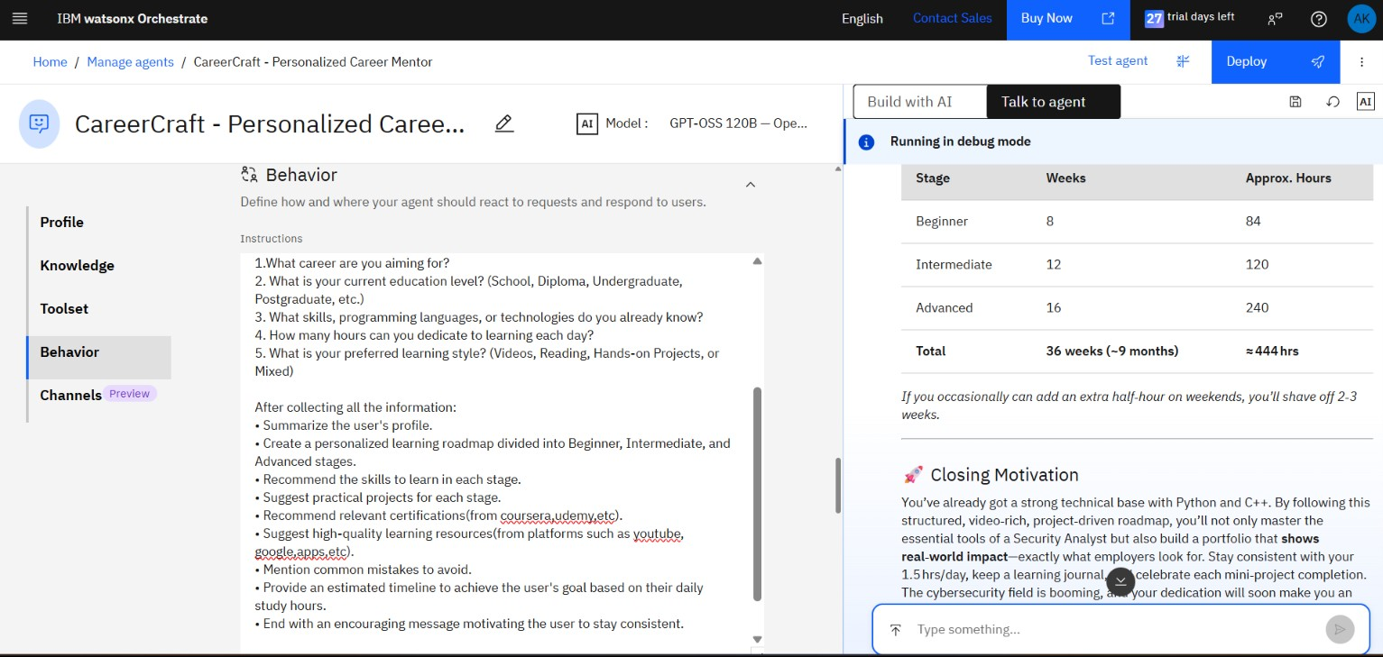
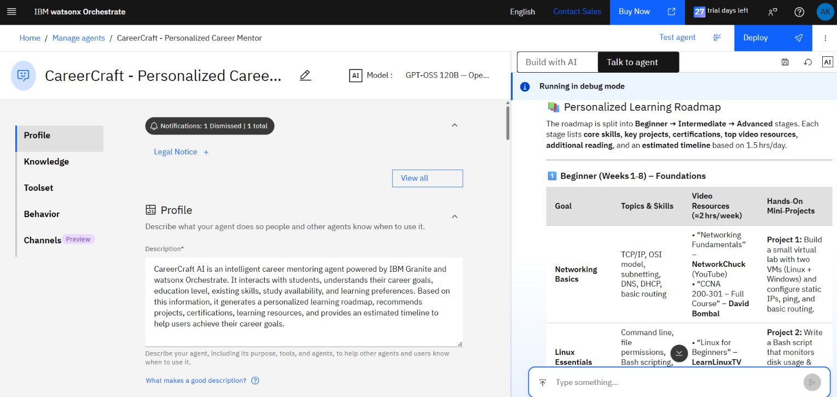
Working and output by the Agent.

Slide 15
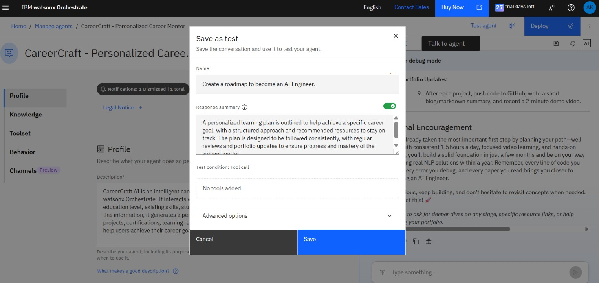

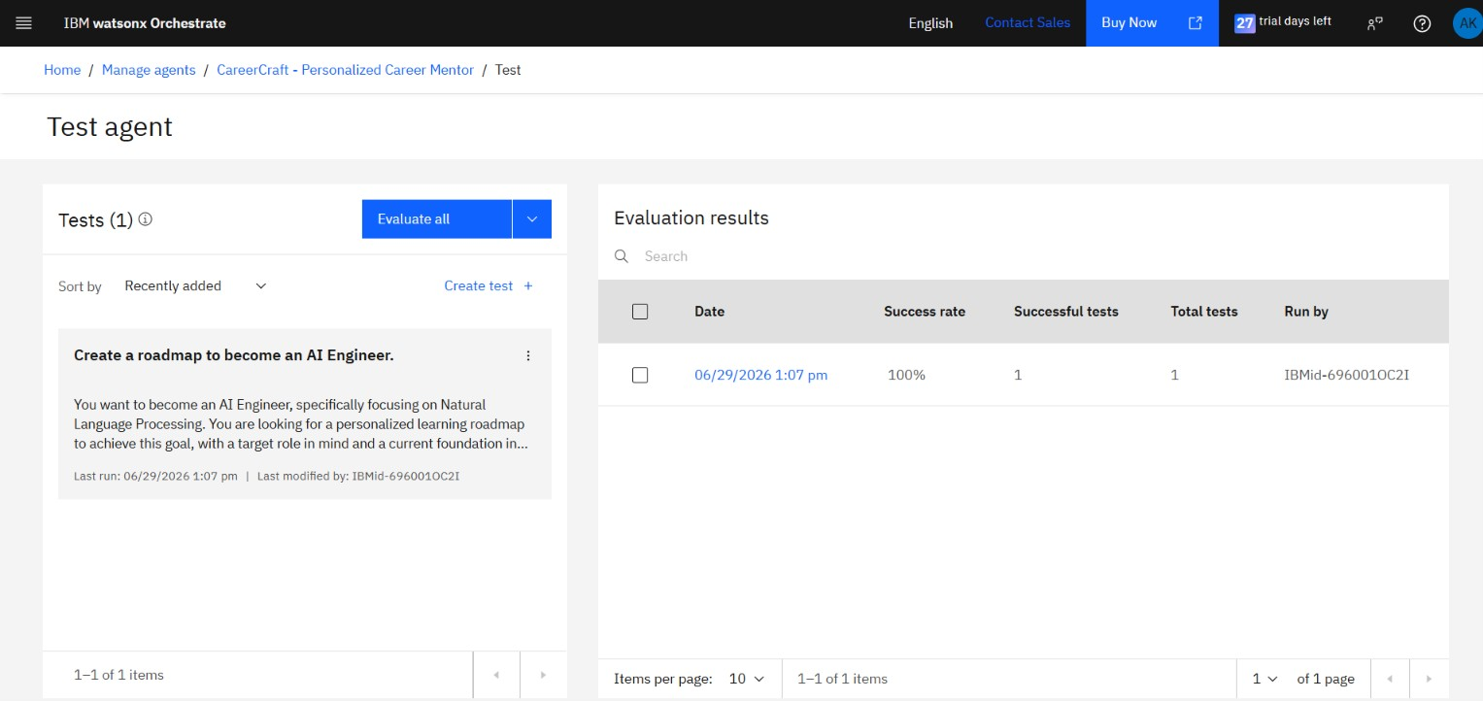
Conducting and Evaluating Tests

Slide 16
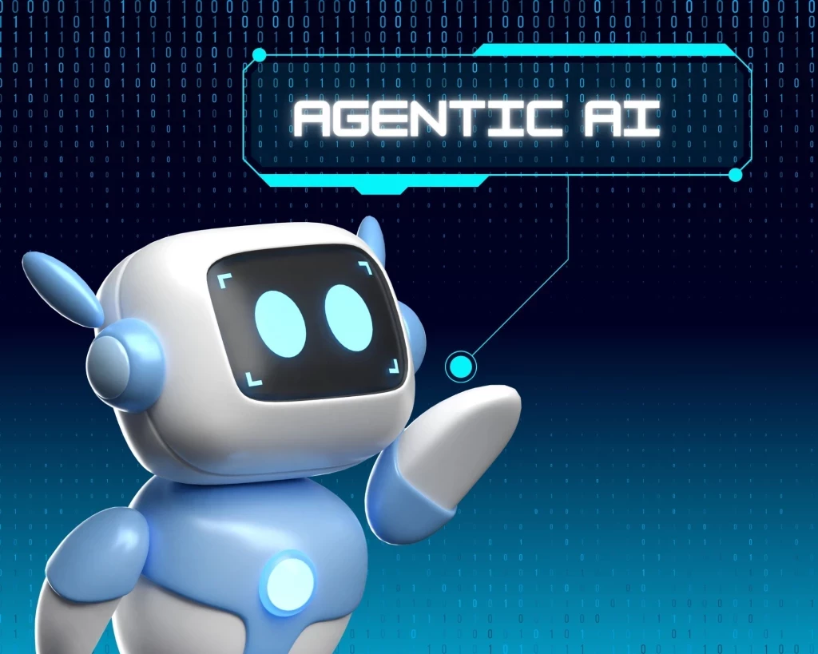
Role of Agentic AI:
CareerCraft AI leverages Agentic AI to deliver an interactive and personalized career mentoring experience rather than functioning as a traditional rule-based chatbot.
The AI agent engages users through a structured conversation, collecting essential information such as career goals, educational background, existing skills, daily study availability, and preferred learning style. Instead of providing generic responses, it analyzes the user's profile and adapts its recommendations accordingly.
Powered by IBM Granite Foundation Models, the agent
generates personalized learning roadmaps, identifies skill gaps,
recommendsrelevant certifications, projects, and learning resources,
and provides resume improvement and interview preparation
guidance.
By combining IBM watsonx.ai Studio for prompt engineering,
watsonx Orchestrate for intelligent conversational workflow,
and IBM Bob for application development, CareerCraft AI acts
as a proactive virtual career mentor, enabling students to make informed career decisions through context-aware, personalized guidance.

Slide 17
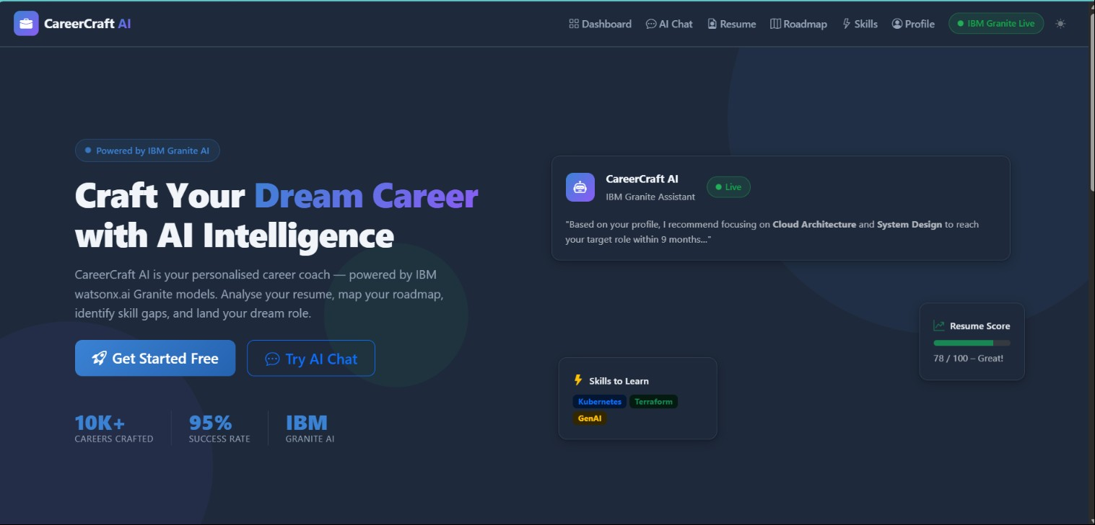
CareerCraft_AI Web Application by IBM BOB Images:

Slide 18
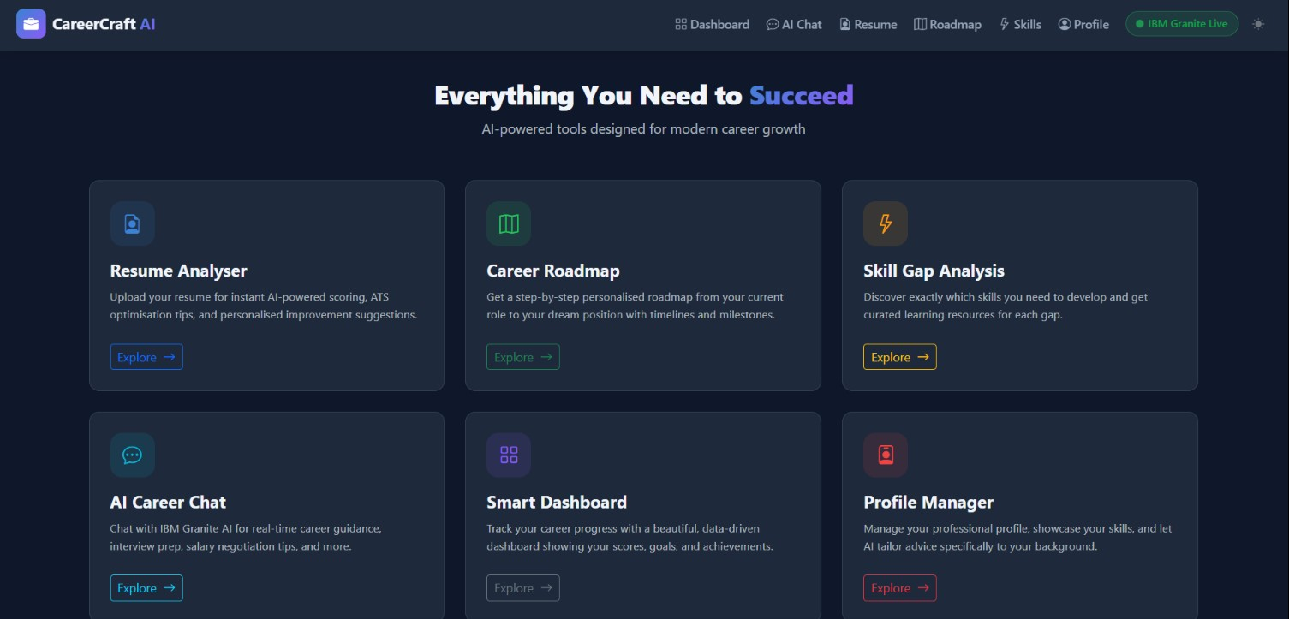
Dashboard providing various options

Slide 19
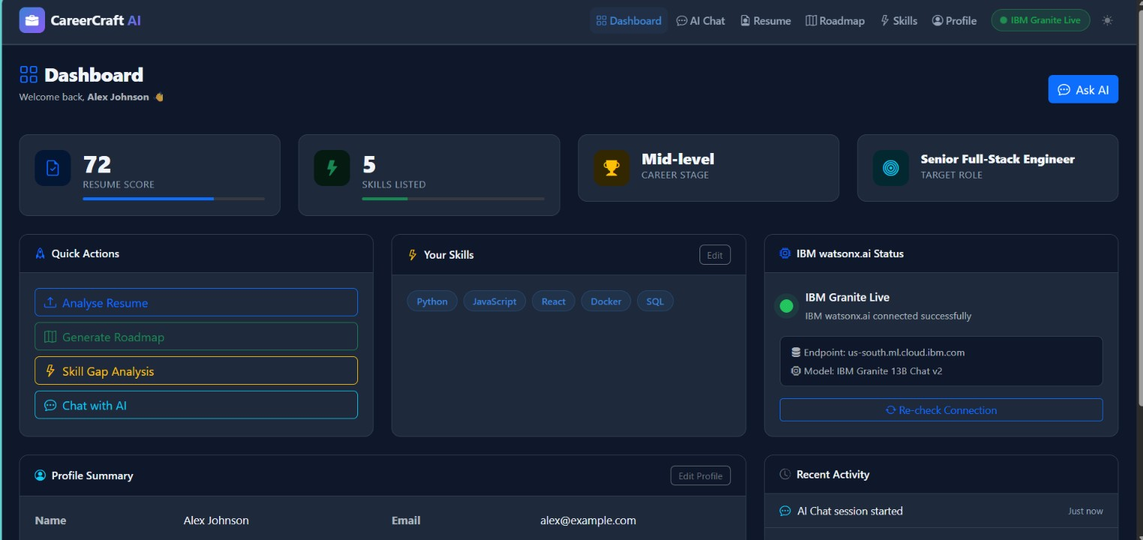
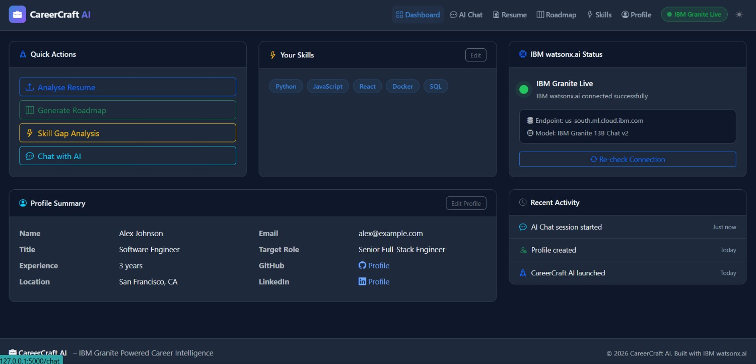

Slide 20
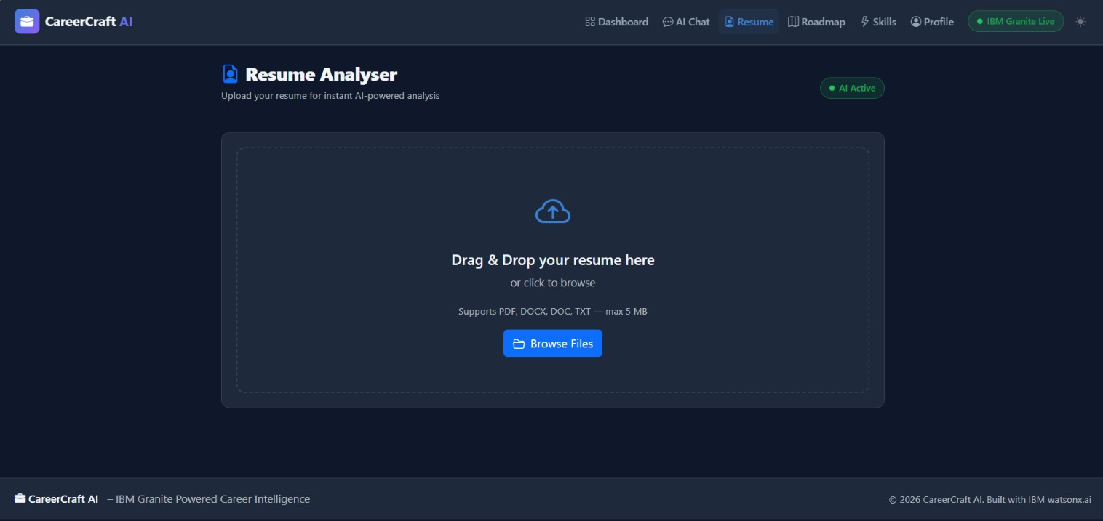
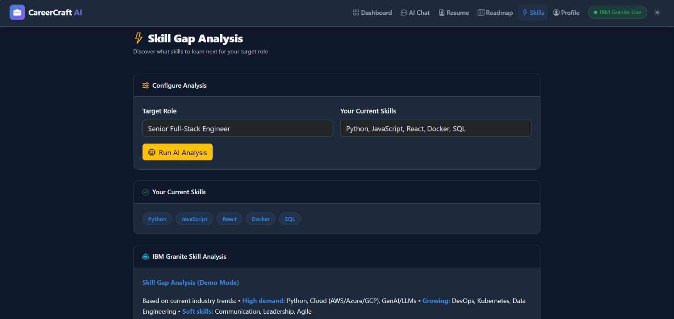
Another feature of analysing Resume
Includes and provides various features like Skill Gap Analysis.

Slide 21
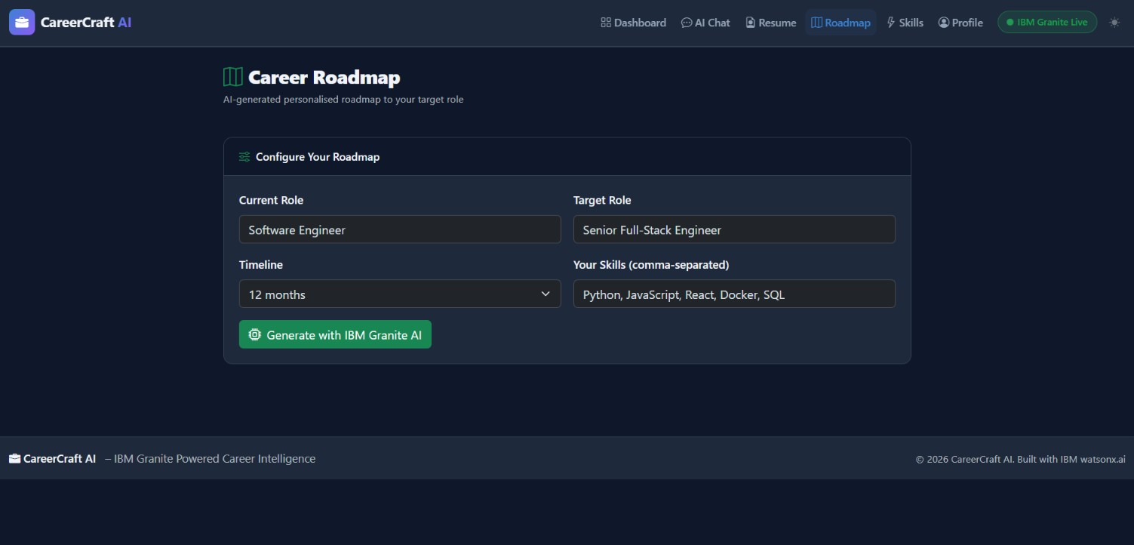
A significant feature offered by CareerCraft AI is creating personalized career roadmaps.

Slide 22
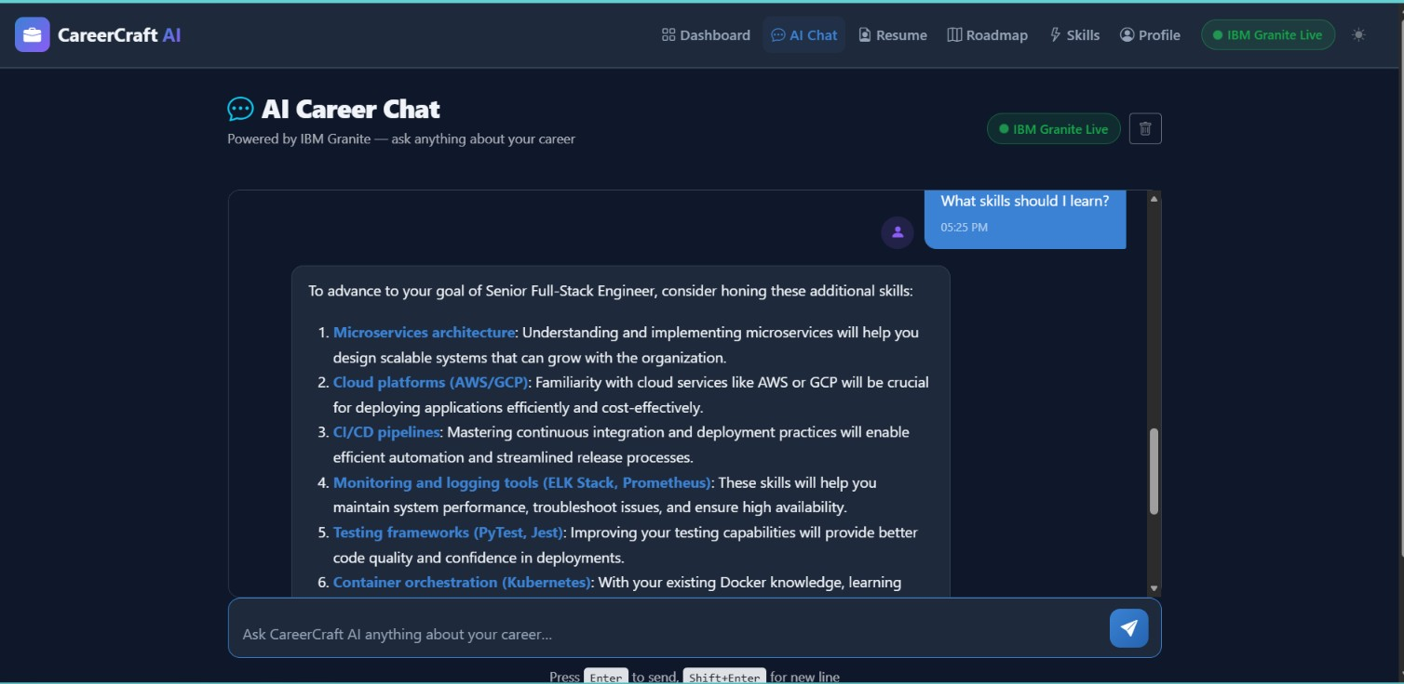
CareerCraft provides suitable and satisfactory answers to question asked by users.

Slide 23
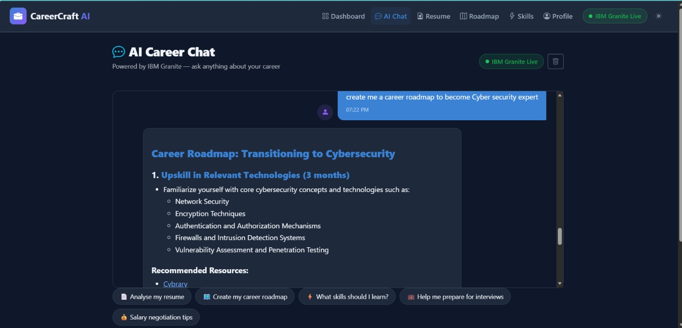
CareerCraft AI analyze the user request and gives the required output.

Slide 24
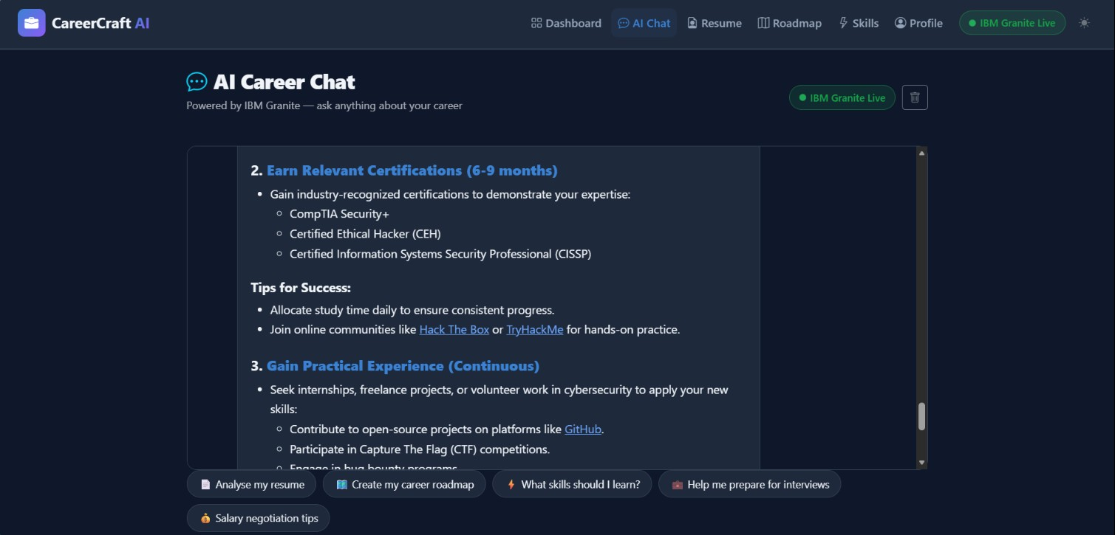
CareerCraft provides required resources and solution for the problem or the request.
Also we can see the ai generated quick start prompt/questions in the bottom.

Slide 25
Novelty and Uniqueness:
Agentic AI-Powered Career Mentoring – Uses an intelligent AI agent to interact with users step-by-step, delivering personalized career guidance instead of static recommendations.
Personalized Learning Roadmaps – Generates customized learning paths based on career goals, education level, existing skills, study availability, and learning preferences.
Comprehensive Career Assistance – Integrates career recommendations, skill gap analysis, project suggestions, certifications, learning resources, resume guidance, and interview preparation into a single platform.
Context-Aware Conversations – Adapts responses dynamically using user-specific information, providing more relevant and meaningful guidance than traditional chatbots.
IBM AI Ecosystem Integration – Combines IBM watsonx.ai Studio, IBM Granite Foundation Models, watsonx Orchestrate, IBM Bob, and IBM Cloud Lite for prompt engineering, intelligent reasoning, agent orchestration, and application development.
Modern AI-Powered Web Application – Features an interactive and responsive web interface developed with IBM Bob and Flask, providing an engaging user experience.
Scalable and Future-Ready Architecture – Designed for future integration with RAG, job portals, LinkedIn, resume parsing, and real-time labor market insights.

Slide 26
Future Scope:
Resume parsing using AI.
Integration with LinkedIn and job portals.
RAG-based real-time course recommendations.
Live labor market trend analysis.
Mobile application.
Multilingual career mentor.

Slide 27
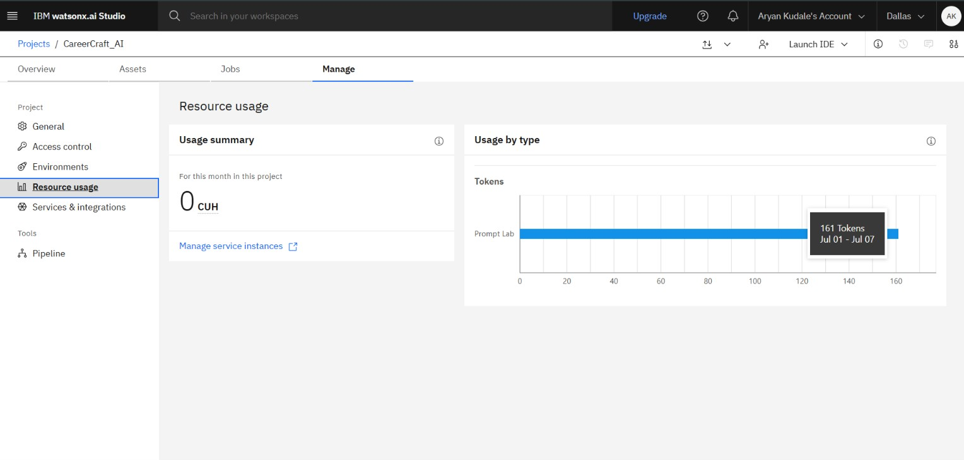
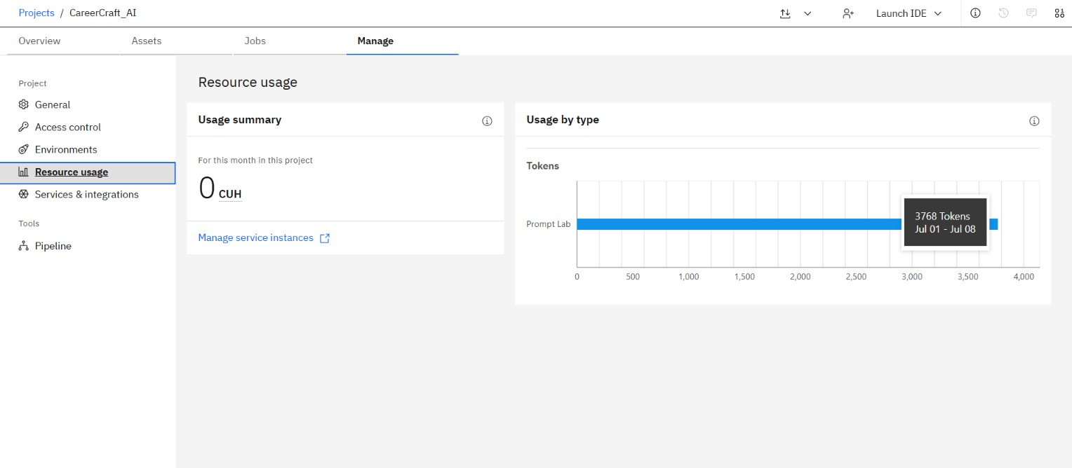
Token usage before
Token usage after

Slide 28
GIT HUB LINK:
https://github.com/aryan-kudale/CareerCraft-AI
Project Title:CareerCraft-AI Powered Personalized Career Guidance Assistant
Developed by: Aryan Kudale

Slide 29
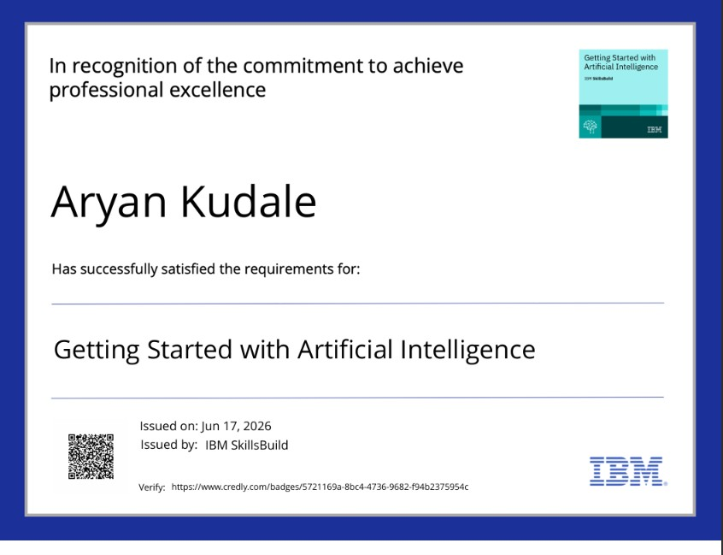
CERTIFICATES EARNED:

Slide 30
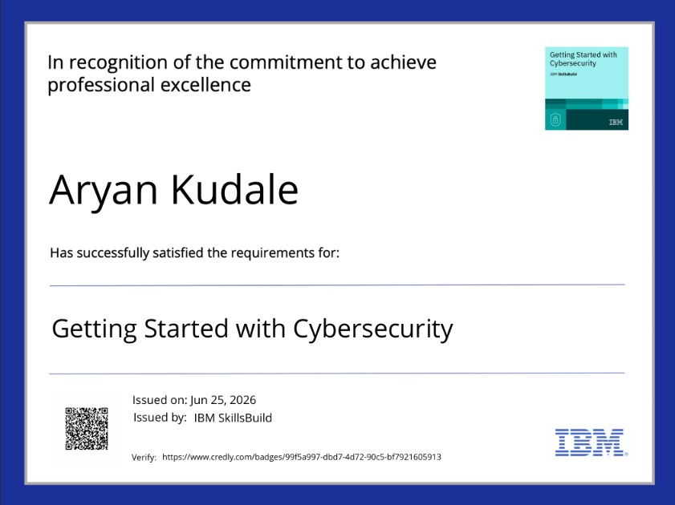

Slide 31
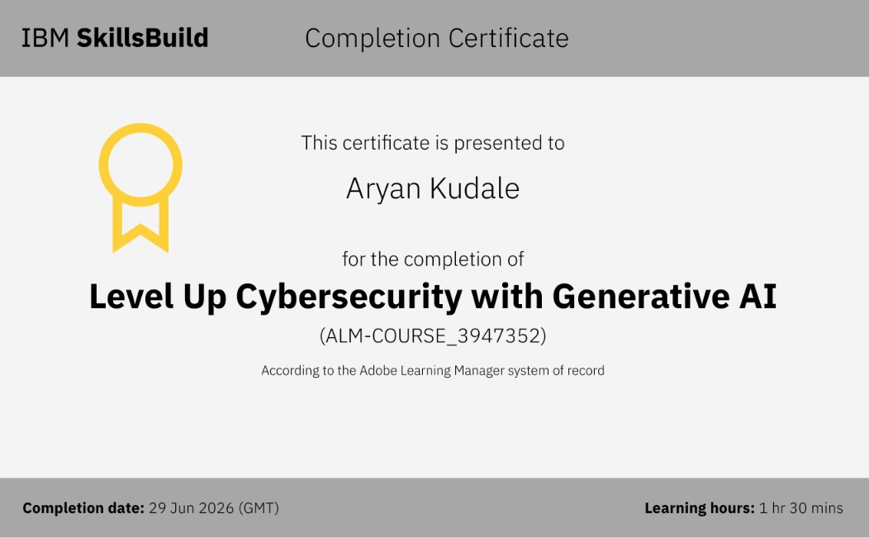

Slide 32
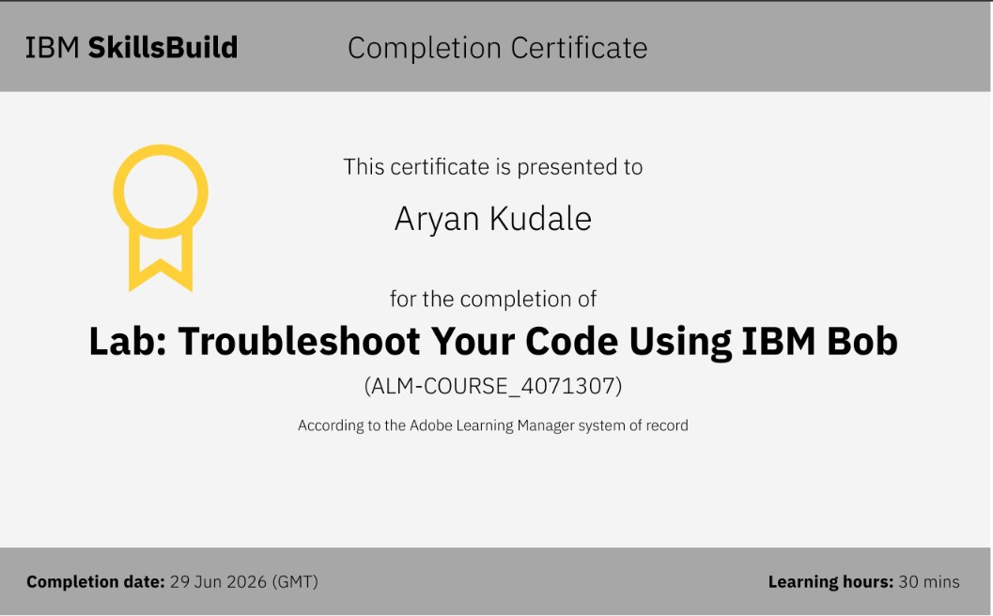

Slide 33
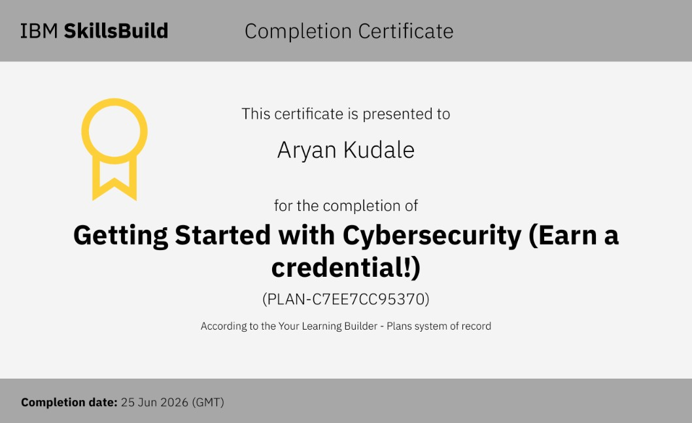

Slide 34
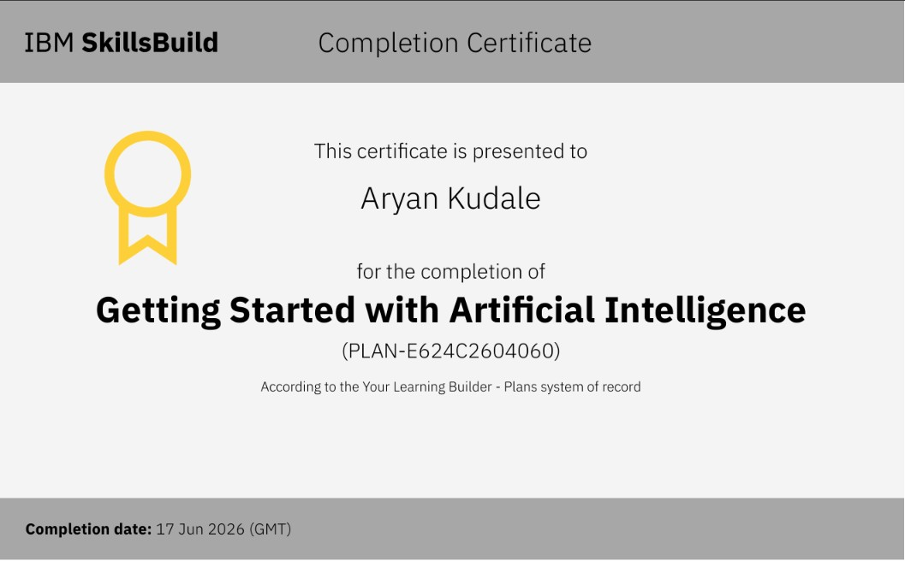

Slide 35
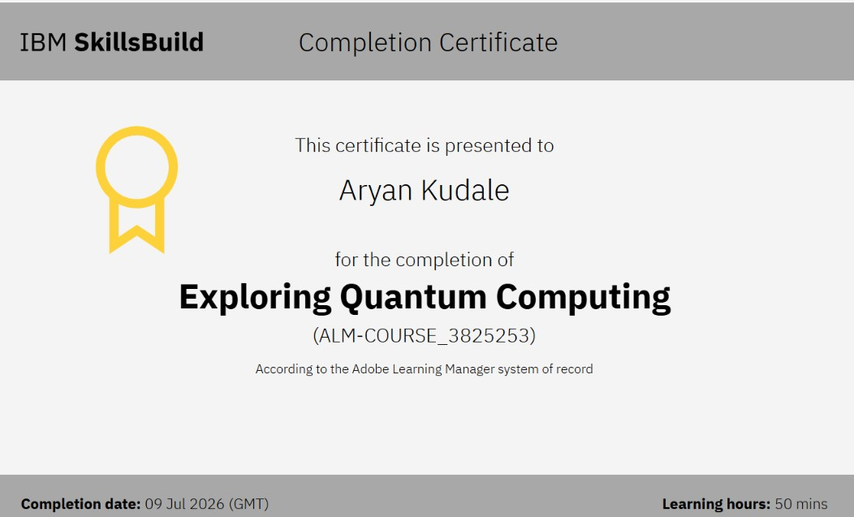

Slide 36
THANK YOU !!
Thank you for your time and interest

